Slide 1







Product Presentation
a product
by
designed in collaboration with

Slide 2

“Get your food the cooler way”

Slide 3
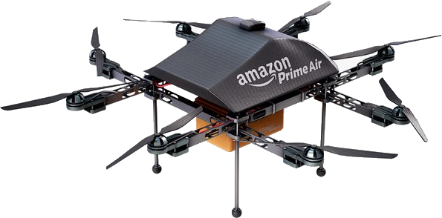
Product1
Refrigerator
Elevator platform
+ Connecting funnel
Mounted on extendable actuators
+ Security hatches
Smartphone app
Different models
+ Website
→ Order food and supplies
Frigid’Air — Insider
Frigid’Air — Outsider
Drone delivery
Developed by Amazon® and Zipline®
Small drone (current)
10 miles — 16 km
5lbs — 2.25 kg
Large drone (project)
25 miles — 40 km
15lbs — 7.75 kg

Slide 4
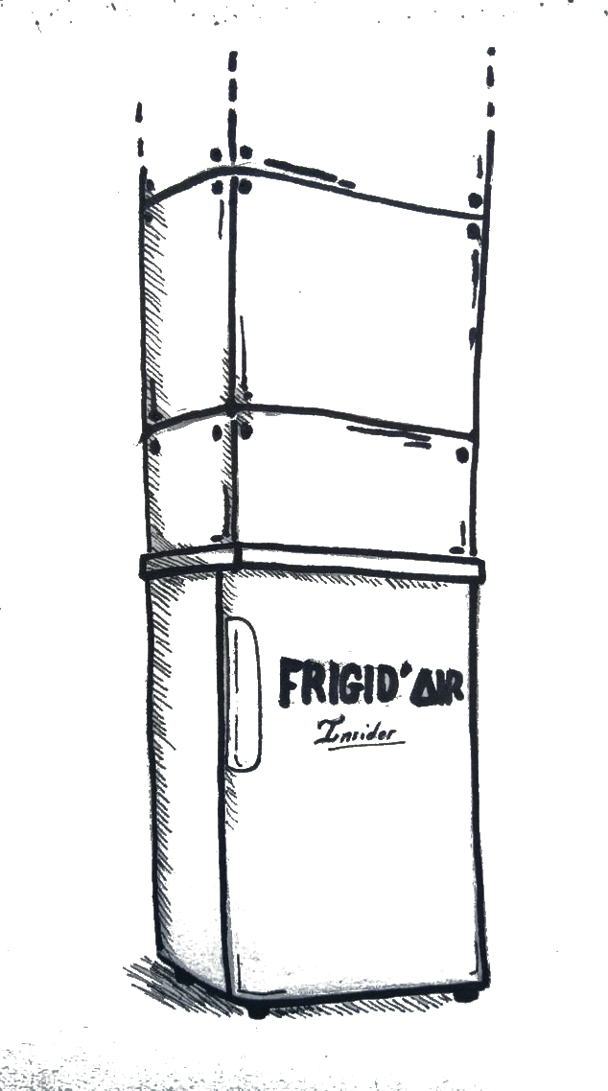
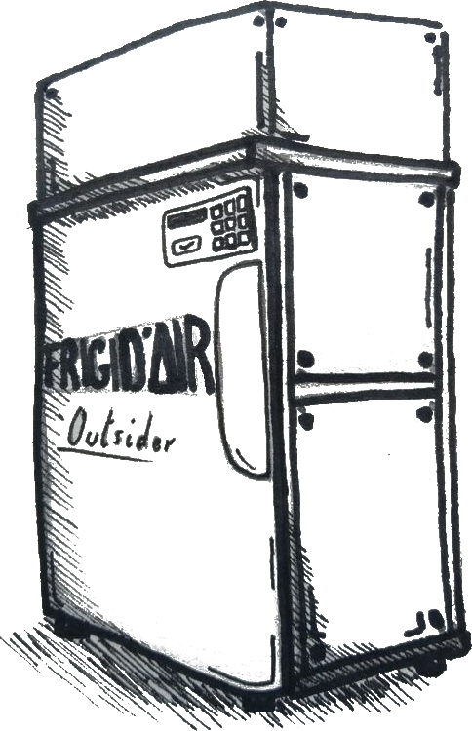

product2
Frigid’Air – Insider
Frigid’Air – Outsider
Installed inside
Requires :
funnel installation
Piercing through the roof
Installed outside (no funnel required)
Additional PIN code lock
Requires :
Complete clearance (5ft. Radius)
(1.5 meters)
Products’ concept arts
Funnel
Pin code lock
Hardened external shell

Slide 5
PLACE

Slide 6

IMPLEMENTATION :
LOCATION AND REASONS
UNITED STATES
House appliance’s factories already established
Keep transportation costs at minimum
Frigid’Air will be only available on our website and Amazon’s
Amazon FAA authorisation

Slide 7
CLIENT’S LOCATION AND TARGETS
People living in the countryside
People living in the city

Slide 8

USING MEANS AND PLACES
Website and development of an app
Buy in a few steps !

Slide 9


FUTURE LOCATIONS AVAILABLE
NOW
EXPECTATIONS

Slide 10
PRICE

Slide 11
PRICE
Insider model :
$999.89
Outsider model :
$1299.89
Additional 3m funnel : $89.99 (after that each additional meter of funnel is charged to $35)
No additional funnel
Heat-proof and resistant materials
Greener energy consumption
Safety lock

Slide 12
PRODUCTION COSTS
$800-900
Of recycled materials
30%
For a regular refrigerator
5 years all-including warranty, maintenance and customer service for FREE
then $99.89 a year free of engagement

Slide 13
PROMOTION

Slide 14



PROMOTION
PARTNERSHIP
PRESENTATION VIDEOS
TRUST
Drones and visibility
Providing Information
To be as reliable as possible

Slide 15
THANK YOU
Yann MARTY, Salomé GRANDJEAN, Ramzi BELOUAR, Shaïm DINAR

